Slide 1

Fake News detection USING MACHINE LEARNING
DR.Deepika varshney
Artifcial intelligence

Slide 2
Sachin Kumar giri,yash thenuia
ROLL NO 2K18/IT/102,2k18/IT/136
BRANCH-INFORMATION TECNOLOGY
DELHI TECHNOLOGICAL UNIVESITY

Slide 3
Agenda
Abstract
OBJECTIVE
INTRODUCTION
EXISTING SYSTEM
Research
PROPOSED SYSTEM
COLLECTING DATA
REQUIREMENTS
Model
Confusion matrix
Real world application
Case – Study
Real World implementation
Imporvement
RESULTS
REFERENCES

Slide 4
Abstract
This Project comes up with the applications of NLP (Natural Language Processing) techniques for detecting the 'fake news', that is, misleading news stories that comes from the non-reputable sources.
Only by building a model based on a count vectorizer (using word tallies) or a (Term Frequency Inverse Document Frequency) tfidf matrix, (word tallies relative to how often they’re used in other articles in your dataset) can only get you so far. But these models do not consider the important qualities like word ordering and context.
. It is very possible that two articles that are similar in their word count will be completely different in their meaning. The data science community has responded by taking actions against the problem.

Slide 5
OBJECTIVE
The main objective is to detect the fake news,
which is a classic text classification problem with a straight forward proposition.
It is needed to build a model that can differentiate between “Real” news and “Fake” news

Slide 6
INTRODUCTION
These days’ fake news is creating different issues from sarcastic articles to a fabricated news and plan government propaganda in some outlets. Fake news and lack of trust in the media are growing problems with huge ramifications in our society. Obviously, a purposely misleading story is “fake news “ but lately blathering social media’s discourse is changing its definition. Some of them now use the term to dismiss the facts counter to their preferred viewpoints.
The importance of disinformation within American political discourse was the subject of weighty attention , particularly following the American president election . The term 'fake news' became common parlance for the issue, particularly to describe factually incorrect and misleading articles published mostly for the purpose of making money through page views. In this paper,it is seeked to produce a model that can accurately predict the likelihood that a given article is fake news.
Facebook has been at the epicenter of much critique following media attention. They have already implemented a feature to flag fake news on the site when a user sees’s it ; they have also said publicly they are working on to to distinguish these articles in an automated way. Certainly, it is not an easy task. A given algorithm must be politically unbiased – since fake news exists on both ends of the spectrum – and also give equal balance to legitimate news sources on either end of the spectrum. In addition, the question of legitimacy is a difficult one.However, in order to solve this problem, it is necessary to have an understanding on what Fake News is. Later, it is needed to look into how the techniques in the fields of machine learning, natural language processing help us to detect fake news.

Slide 7
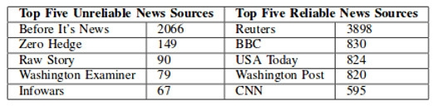
EXISTING SYSTEM
There exists a large body of research on the topic of machine learning methods for deception detection, most of it has been focusing on classifying online reviews and publicly available social media posts. Particularly since late 2016 during the American Presidential election, the question of determining 'fake news' has also been the subject of particular attention within the literature.

Slide 8
PROPOSED SYSTEM
In this paper a model is build based on the count vectorizer or a tfidf matrix ( i.e ) word tallies relatives to how often they are used in other artices in your dataset ) .
Since this problem is a kind of text classification, Implementing a Naive Bayes classifier will be best as this is standard for text-based processing.
The actual goal is in developing a model which was the text transformation (count vectorizer vs tfidf vectorizer) and choosing which type of text to use (headlines vs full text).
Now the next step is to extract the most optimal features for countvectorizer or tfidf-vectorizer,
this is done by using a n-number of the most used words, and/or phrases, lower casing or not,
mainly removing the stop words which are common words such as “the”, “when”, and “there” and only using those words that appear at least a given number of times in a given text dataset.

Slide 9
COLLECTING DATA
So, there must be two parts to the data-acquisition process, “fake news” and “real news”.
Collecting the fake news was easy as Kaggle released a fake news dataset consisting of 13,000 articles published during the 2016 election cycle.
Now the later part is very difficult.
That is to get the real news for the fake news dataset. It requires huge work around many Sites because it was the only way to do web scraping thousands of articles from numerous websites.
With the help of web scraping a total of 5279 articles, real news dataset was generated, mostly from media organizations (New York Times, WSJ, Bloomberg, NPR, and the Guardian) which were published around 2015 – 2016.

Slide 10
REQUIREMENTS
Google colab
Python
numpy
pandas
itertools
matplotlib
sklearn
Dataset from Kaggle

Slide 11
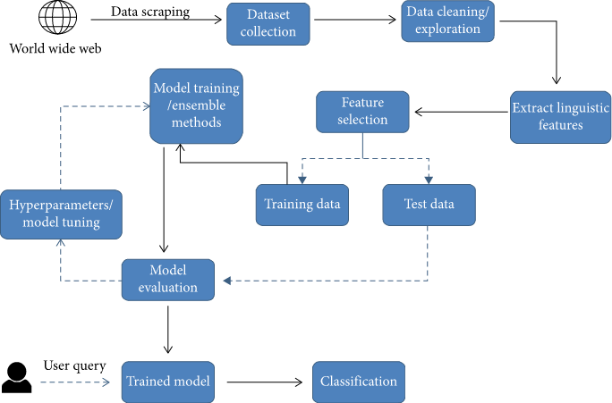
model

Slide 12
Logistic Regression
Logistic regression is a statistical model that in its basic form uses a logistic function to model a binary dependent variable, although many more complex extensions exist. In regression analysis, logistic regression^{[1]} (or logit regression) is estimating the parameters of a logistic model (a form of binary regression). Mathematically, a binary logistic model has a dependent variable with two possible values, such as pass/fail which is represented by an indicator variable, where the two values are labeled "0" and "1". In the logistic model, the log-odds (the logarithm of the odds) for the value labeled "1" is a linear combination of one or more independent variables ("predictors"); the independent variables can each be a binary variable (two classes, coded by an indicator variable) or a continuous variable (any real value).

Slide 13

. Decision Tree Classification
Decision tree builds classification or regression models in the form of a tree structure. It breaks down a dataset into smaller and smaller subsets while at the same time an associated decision tree is incrementally developed. Decision trees can handle both categorical and numerical data. ..
There are two main types of decision trees that are based on the target variable, i.e., categorical variable decision trees and continuous variable decision trees.
Categorical variable decision tree. ...
Continuous variable decision tree. ...
Assessing prospective growth opportunities

Slide 14
Gradient Boosting Classifier
Gradient boosting classifiers are a group of machine learning algorithms that combine many weak learning models together to create a strong predictive model. Decision trees are usually used when doing gradient boosting.
It is a technique of producing an additive predictive model by combining various weak predictors, typically Decision Trees. Gradient Boosting Trees can be used for both regression and classification. Here, we will use a binary outcome model to understand the working of GBT

Slide 15
Random Forest Classifier
Random forest classifier creates a set of decision trees from randomly selected subset of training set. It then aggregates the votes from different decision trees to decide the final class of the test object.
random forest builds multiple decision trees and merges them together to get a more accurate and stable prediction. Random forest has nearly the same hyperparameters as a decision tree or a bagging classifier. ... Random forest adds additional randomness to the model, while growing the trees.
random forest is a collection of decision trees. ... With that said, random forests are a strong modeling technique and much more robust than a single decision tree. They aggregate many decision trees to limit overfitting as well as error due to bias and therefore yield useful results.

Slide 16
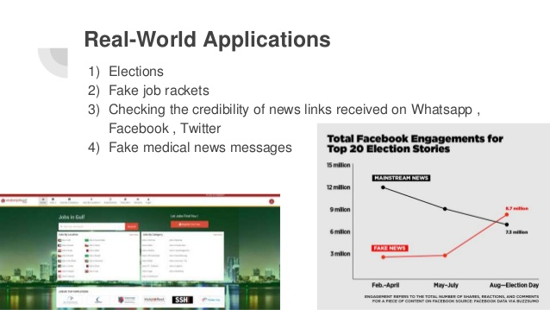

Slide 17
Case Study-Job rackets
fishing at reputed job portals: Another way of conning job aspirants is through reputed job portals where racketeers fish for personal details of job seekers and exploit them later.
"They build a database of critical personal information of unsuspecting candidates which can be dangerously misused at a later point,” says Chakraborty. In June, police arrested three men from Kavi Nagar in Ghaziabad for allegedly cheating several job seekers of around Rs 3.5 crore in the last two years.
The mastermind of the racket posed on Naukri.com as representative of fictitious companies such as Idea International and Entomace Technology India Pvt Ltd and posted jobs. He would collect personal data of candidates who applied to those jobs. Later, he would send them fake interview letters from big, well-known companies. He wanted the candidates to pay through Paytm for fixing the interviews so they would get those jobs.

Slide 18
Cleaning
Pre-processing data is a normal first step before training and evaluating the data using a neural network.
Machine learning algorithms are only as good as the data you are feeding them.
It is crucial that data is formatted properly and meaningful features are included in order to have sufficient consistency that will result in the best possible results.
for computer vision machine learning algorithms, pre-processing the data involves many steps including normalizing image inputs and dimensionality reduction.
The goal of these is to take away some of the unimportant distinguishing features between different images.
Features like the darkness or brightness are not beneficial in the task of labeling the image.
Similarly, there are portions of text that are not beneficial in the task of labeling the text as real or fake.

Slide 19
Real-World Implementation
In the future, our improved model could also consider individual news stories and not just the news website as a whole.
To implement this in real life, we can make a mobile app or a Whatsapp-integrated feature.
Users would simply enter the link of a news website and be able to verify whether a news website is true or fake.

Slide 20
TO IMPROVE
Instead of using only 16 features, we changed to using 616 features in our word-2-vec model, which was one of the key factors for improving our accuracy
Using controversial words which were seen to appear more in fake news than in real. Eg. bombing, terrorist, Trump

Slide 21
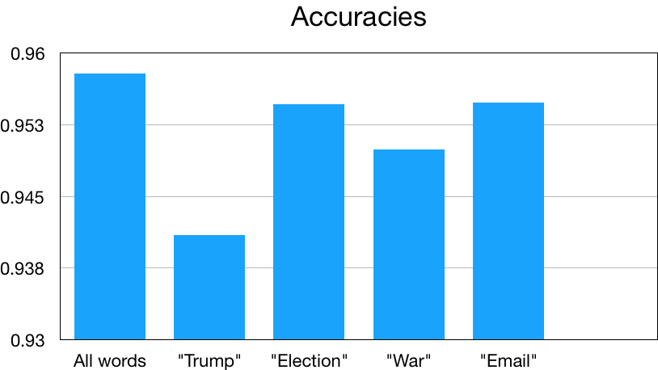
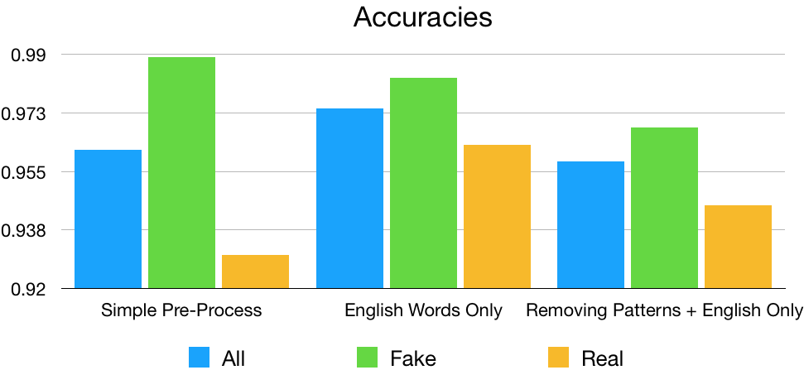
ACCURACIES

Slide 22
Conclusion
The main contribution of this project is support for the idea that machine learning could be useful in a novel way for the task of classifying fake news.
Our findings show that after much pre-processing of relatively small dataset, a simple CNN is able to pick up on a diverse set of potentially subtle language patterns that a human may (or may not) be able to detect
Many of these language patterns are intuitively useful in a humans manner of classifying fake news. Some such intuitive patterns that our model has found to indicate fake news include generalizations, colloquialisms and exaggerations

Slide 23
FUTURE WORK
Through the work done in this project, we have shown that machine learning certainly does have the capacity to pick up on sometimes subtle language patterns that may be difficult for humans to pick up on.
The next steps involved in this project come in three different aspects. The first of aspect that could be improved in this project is augmenting and increasing the size of the dataset.
The next steps involved in this project come in three different aspects. The first of aspect that could be improved in this project is augmenting and increasing the size of the dataset.
The second aspect in which this project could be expanded is by comparing it to humans performing the same task.
Comparing the accuracies would be beneficial in deciding whether or not the dataset is representative of how difficult the task of separating fake from real news is
If humans are more accurate than the model, it may mean that we need to choose more deceptive fake news examples. Because we acknowledge that this is only one tool in a toolbox that would really be required for an end-to-end system for classifying fake news,
If humans are more accurate than the model, it may mean that we need to choose more deceptive fake news examples. Because we acknowledge that this is only one tool in a toolbox that would really be required for an end-to-end system for classifying fake news,

